Slide 1
RDBMS Fundamentals

Slide 2
Module 1
Architecture of RDBMS

Slide 3
What is DBMS :
A DBMS is a software that allows creation, definition and manipulation of database, allowing users to store, process and analyze data easily. DBMS provides us with an interface or a tool, to perform various operations like creating database, storing data in it, updating data, creating tables in the database and a lot more.

Slide 4
Database Management Systems (DBMSs)
DBMS: a collection of general-purpose, application-independent programs
providing services :
Data Model all data stored in a well defined way
Access control only authorized people get to see/modify it
Concurrency control multiple concurrent applications access data
Database recovery nothing gets accidentally lost
Database maintenance
Notes:
DBMS software is application-independent ⇒ it consults the database structure in the data dictionary to understand and execute application programs
define the structure of a database, i.e., data types and constraints that the data will have to satisfy
Manage the storage of data, safely for long periods of time, on some storage
Manipulate a database, with efficient user interfaces to query the database
Manage database usage users with their access rights, performance optimization,sharing of data among several users, security from accidents or unauthorized use

Slide 5
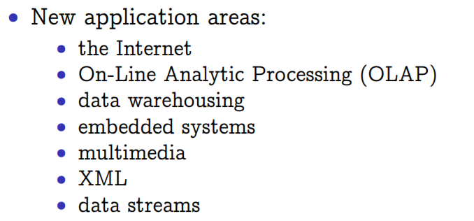
Database Applications : Databases touch all aspects of our lives
Banking: all transactions
Airlines: reservations, schedules
Universities: registration, grades
Sales: customers, products, purchases
Manufacturing: production, inventory, orders, supply chain
Human resources: employee records, salaries, tax deductions
Some popular DBMS :
Oracle
SQL Server
MySql
IBM DB2
PostgreSQL
Amazon SimpleDB (cloud based) etc.

Slide 6
Data Model
A data model is a collection of concepts and rules for the description of the structure of the database. Structure of the database means the data types, the constraints and the relationships for the description or storage of data respectively. .

Slide 7
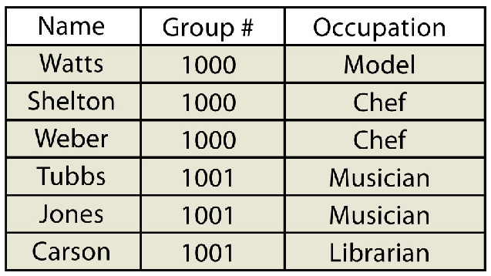
Flat File Model
Flat File Model
A Flat File is a plain text or binary file which contains one record per line.
Within each such record, the individual fields are separated by delimiters such as
commas or special characters or the fields themselves are designed to be of a fixed length.
3. There are no structural relationships between the records.
Various problems associated with this data model.
Data redundancy and inconsistency
Integrity Problem
Concurrency issues
Data integrity
Security, authorization and selective access
Today, the Flat file Model is used only for the simplest and most basic of database solutions
Notes:
Difficulty in accessing data

Slide 8
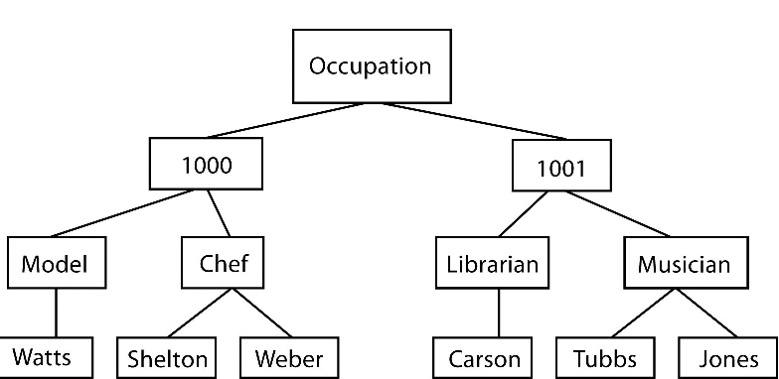
Hierarchical Data Model
Hierarchical Data Model
The hierarchical data model is based on links between the various components / entities in the application.
The Hierarchical Model structures data as a tree of records, with one-way links between them.
Various problems associated with this data model.
The links can designed to expand vertically or horizontally.
The only links in a hierarchical data model can be to a superior level or a subordinate level. This model is therefore not appropriate for defining real world entities and relationships.
Additionally, on the deletion of a higher level entity, all its lower level entities stand to be orphaned.

Slide 9
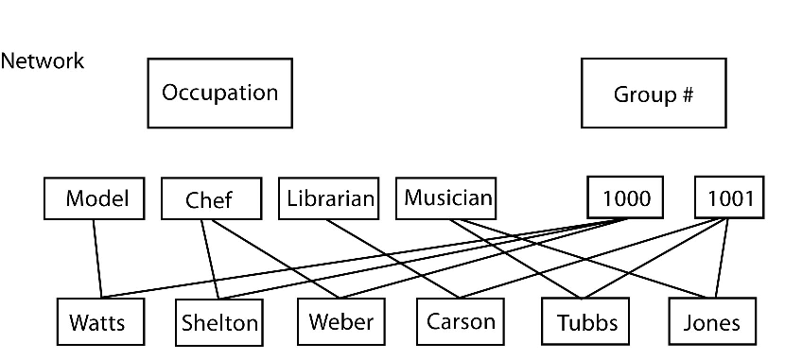
NetWork Data Model
Network Data Model
The Network Data Model was conceived as a flexible way of representing objects and their relationships.
Relationships between entities are not restricted by supporting “many-to-many” relationships which allows greater search flexibility within the dataset
Various problems associated with this data model.
Network models can become incredibly complex depending on the size of the databases and the number of interactions between the data points.

Slide 10
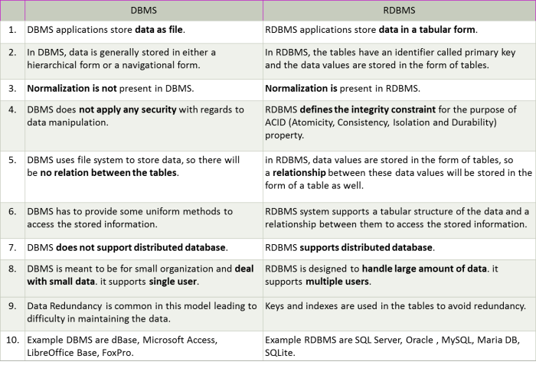
DBMS AND RDBMS
Notes:
DBMS software is application-independent ⇒ it consults the database structure in the data dictionary to understand and execute application programs
define the structure of a database, i.e., data types and constraints that the data will have to satisfy
Manage the storage of data, safely for long periods of time, on some storage
Manipulate a database, with efficient user interfaces to query the database
Manage database usage users with their access rights, performance optimization,sharing of data among several users, security from accidents or unauthorized use

Slide 11
Transactions –ACID properties
Atomicity : What if the OS crashed after $100 was deposited to the first account’?
DBMS must assure that the $100 is withdrawn from the first account.
Consistency: What if a transaction just deposited $100 into an account’?
The programmer must ensure that all transactions are consistent
Isolation: What if another transaction computed the total bank balance after $100 was deposited to the first account’?
Durability: What if, after the commit, the OS crashed before the withdrawal was written to disk’?
DBMS must assure that the withdrawal was at least logged.

Slide 12
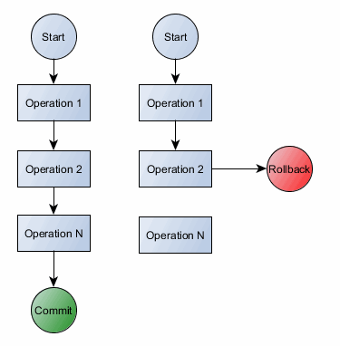
Transactions –ACID properties
Atomic : A transaction occurs entirely or not at all
Consistency : each transaction preserves the consistency of the database
Isolated : concurrent transactions do not interface with each other
Durable : once completed, a transaction's changes are permanent
Notes:
The ACID Properties of Transactions
Atomicity: A transaction happens in its entirety or not at all— What ifthe OS crashed after $100 was deposited to the first account’?— The recoverymanager ofthe DBMS must assurethat the $100 is withdrawnfrom the first account.
Consistency: If the DB starts in a consistent state, (this notion is defined by the user; some of it may be enforced by integrity constraints)the transaction will transform it into a consistent state.— What if a transaction just deposited $100 into an account’?— The programmer must ensure that all transactions are consistent.
If the money deposit process has any Trigger built on top of it. And at the time of money transfer any of the Trigger fails or any database node, the system should automatically Rollback the complete transaction and switch back the system to its previous consistent state before the transaction was started. Or if everything executes successfully then the system is committed to a new consistent state.
Isolation: Each transaction is isolated from other transactions.The effect on the DB is as ifthe transaction executed by itself.— What if another transaction computed the total bank balance after $100 wasdeposited to the first account’?— The concurrency control subsystem must ensurethat all transactions run inisolation, unlessthe DBA chooses a less strict level ofisolation.Durability: If a transaction commits, its changes to the database statepersist (changes are permanent)— What if, after the commit, the OS crashed before the withdrawal was writtento disk’?— The recovery manager must assure that the withdrawal was at least logged.Slide 6

Slide 13
Relational Database Model
A relational database management system (RDBMS) is the basis for all modern database systems like MS SQL Server, IBM DB2, Oracle, MySQL, and Microsoft Access.
A Relational database management system (RDBMS) is a database management system (DBMS) that is based on the relational model as introduced by E. F. Codd
RDBMS is a collection of tables that are connected in such a way that that data can be accessed without reorganization of the tables. The tables are created such that each column represents a particular attribute
Notes:
The Relational Model and Logical Structure of an RDBMS
The Relational Data Model was invented by E.F. Codd.
All data in an RDBMS is stored in a TABLE structure, composed of horizontal tuples commonly known as rows, and vertical attributes, commonly known as columns.
The TABLE is an entirely logical structure. They are not physical flat files that reside in the operating system's file structure. For e.g. in a DBMS like FoxPro or Dbase, if you
would create a table to store the above data, it would create a physical file that you could identify and locate on the file system.
All the data including the metadata about the table itself is scattered over different areas
RBMS Concepts and SQL of the RDBMS, and not in one single location. All the metadata is stored in the RDBMS' Data Dictionary tables.
However, as the end user, we need not concern ourselves with pulling the data from different locations. On providing the appropriate command, the RDBMS will ensure all
the relevant data is presented to you in the specified manner. As the end-user, we only need to relate to the data in the simple TABLE structure of rows and columns. The
complexities of how the data is actually stored and later retrieved are handled by the RDBMS.
To sum up, the only thing physical is the actual data stored in the RDBMS, and this is accessed through the logical table structures.
A relational database management system (RDBMS) is a collection of tables that are connected in such a way that that data can be accessed without reorganization of the tables. The tables are created such that each column represents a particular attribute (e.g., soil type, PIN number, last name, acreage) and each row contains a unique instance of data for that columnar attribute (e.g., Delhi Sands Soils, 5555, Smith, 412.3 acres)
In the relational model, each table (not surprisingly called a relation) is linked to each other table via predetermined keys (Date 1995). ^{[4]} The primary key represents the attribute (column) whose value uniquely identifies a particular record (row) in the relation (table). The primary key may not contain missing values as multiple missing values would represent nonunique entities that violate the basic rule of the primary key. The primary key corresponds to an identical attribute in a secondary table (and possibly third, fourth, fifth, etc.) called a foreign key. This results in all the information in the first table being directly related to the information in the second table via the primary and foreign keys, hence the term “relational” DBMS. With these links in place, tables within the database can be kept very simple, resulting in minimal computation time and file complexity. This process can be repeated over many tables as long as each contains a foreign key that corresponds to another table’s primary key.

Slide 14
RDBMS Architecture
A schema is a description of the data interface to the database
The internal schema(Physical schema) describes the physical grouping of the data and the use of the storage space. This schema level decides the way how the data is actually physically stored on some storage medium
The conceptual(logical) schema describes the basic construction of the data structures or database objects. This schema level describes what data are stored in the database in terms of objects, and what relationships exist among those objects
The external schema(application) of a specific application, generally, only highlights that part of the logical scheme which is relevant for its application.
Notes:
A schema is a description of the data interface to the database (i.e.,how the data is organized).
. Physical: Describes how a record (e.g., customer) is stored.
Logical : relationships among the data.
type customer = record
name : string;
street : string;
city : integer;
View level: application programs hide details of data types. Views can also hide information (e.g., salary) for security purposes.

Slide 15
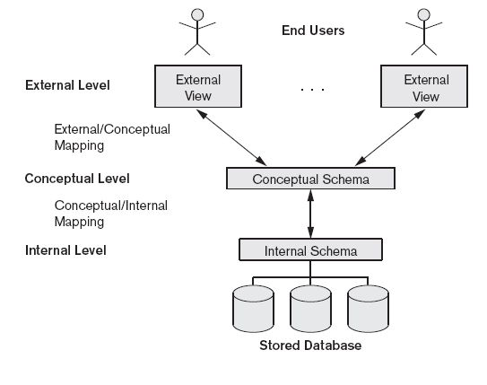
RDBMS Architecture

Slide 16
Schema Architecture and Data Independence
Data independence: possibility to change the schema at one level without
having to change it at the next higher level (nor having to change programs that access it at that higher level)
logical data independence: an external schema (and programs that access it) is insulated from changes that does not concern it in in the community schema (and in the physical schema)
Physical data independence: the community and external schemas are
insulated from changes in the physical schema

Slide 17
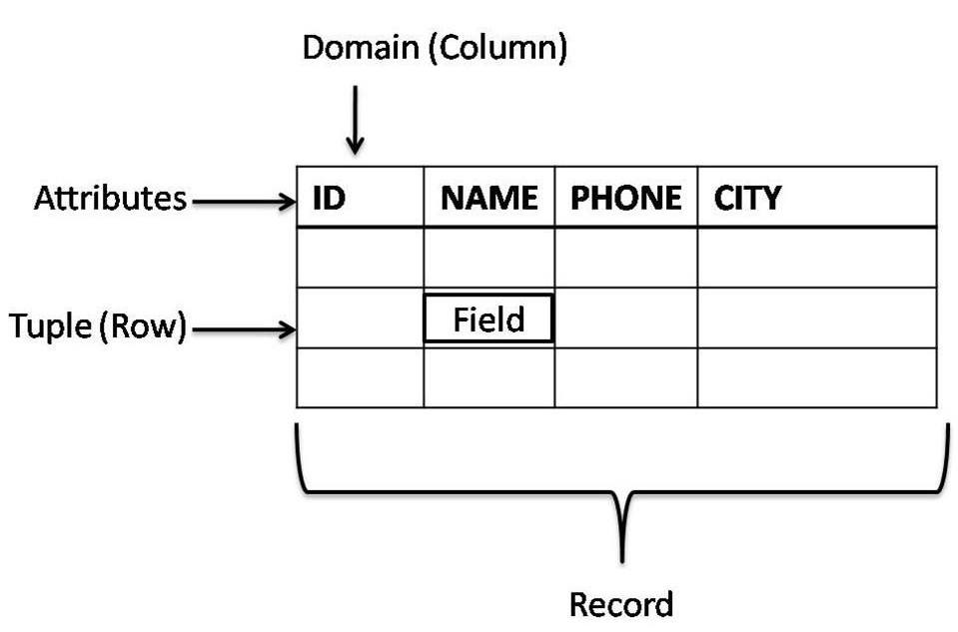
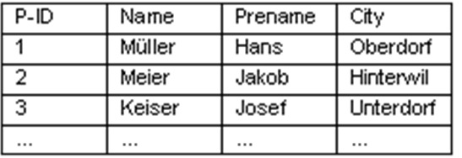
Relational Model
Relational Model defines a database as a collection of tables (relations) which contain all data composed of horizontal tuples commonly known as rows, and vertical attributes, commonly known as columns.
Notes:
The TABLE is an entirely logical structure. They are not physical flat files that reside in the operating system's file structure. For e.g. in a DBMS like FoxPro or Dbase, if you
would create a table to store the above data, it would create a physical file that you could identify and locate on the file system.

Slide 18
Relational Model
The TABLE is an entirely logical structure.
All the data including the metadata about the table itself is scattered over different areas of the RDBMS, and not in one single location.
All the metadata is stored in the RDBMS’ Data Dictionary tables.
The complexities of how the data is actually stored and later retrieved are handled by the RDBMS.
AS the end user, we need not concern ourselves with pulling the data from
different locations.
Notes:
However, as the end user, we need not concern ourselves with pulling the data from
different locations. On providing the appropriate command, the RDBMS will ensure all
the relevant data is presented to you in the specified manner. As the end-user, we only
need to relate to the data in the simple TABLE structure of rows and columns.

Slide 19


other file Module 2
Normalization and database design

Slide 20
Why Normalize ? – Avoiding Data Anomalies
Normalization is the process of removing redundant data from your tables to improve storage efficiency, data integrity, and scalability.
Normalization generally involves splitting existing tables into multiple ones, which must be re-joined or linked each time a query is issued.

Slide 21
Types Of Anomalies
emp_id | emp_name | emp_address | emp_dept
101 | Rick | Delhi | D001
101 | Rick | Delhi | D002
123 | Maggie | Agra | D890
166 | Glenn | Chennai | D900
166 | Glenn | Chennai | D004
The above table is not normalized. We will see the problems that we face when a table is not normalized.
Redundancy
Update anomaly
Insert anomaly
Delete Anamaly
Notes:
Example: Suppose a manufacturing company stores the employee details in a table named employee that has four attributes: emp_id for storing employee’s id, emp_name for storing employee’s name, emp_address for storing employee’s address and emp_dept for storing the department details in which the employee works. At some point of time the table looks like this:
emp_idemp_nameemp_addressemp_dept101RickDelhiD001101RickDelhiD002123MaggieAgraD890166GlennChennaiD900166GlennChennaiD004The above table is not normalized. We will see the problems that we face when a table is not normalized.
Update anomaly: In the above table we have two rows for employee Rick as he belongs to two departments of the company. If we want to update the address of Rick then we have to update the same in two rows or the data will become inconsistent. If somehow, the correct address gets updated in one department but not in other then as per the database, Rick would be having two different addresses, which is not correct and would lead to inconsistent data.
Insert anomaly: Suppose a new employee joins the company, who is under training and currently not assigned to any department then we would not be able to insert the data into the table if emp_dept field doesn’t allow nulls.
Delete anomaly: Suppose, if at a point of time the company closes the department D890 then deleting the rows that are having emp_dept as D890 would also delete the information of employee Maggie since she is assigned only to this department.
To overcome these anomalies we need to normalize the data. In the next section we will discuss about normalization.

Slide 22
Steps of Normalization
First Normal Form (1NF)
Second Normal Form (2NF)
Third Normal Form (3NF)
Boyce-Codd Normal Form (BCNF)
Fourth Normal Form (4NF)
Fifth Normal Form (5NF)
Sixth Normal Form(6NF)
However, in most practical applications, normalization achieves its best in 3rd Normal Form.

Slide 23
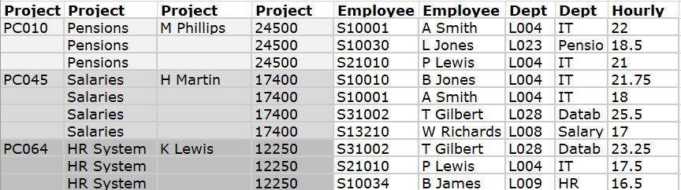
Normalization
Notes:
Extra situations :
Employee Name has two parts – firstName and LastName
Table has a calculated columns like salary based on hourly rate calculations

Slide 24
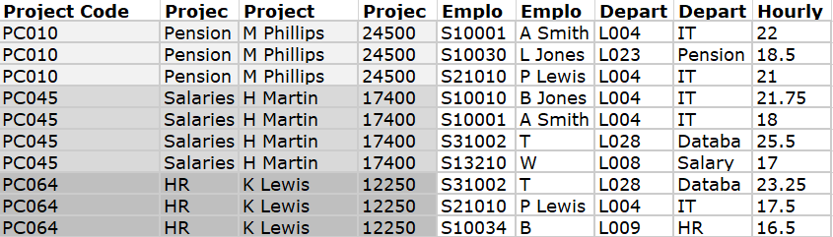
Unnormalized Table
It violates the 1NF because:
It has multivalued columns or Attribute values are not single.
Repeating groups exists.
Example of a table not in 1NF
Notes:
Multivlaued –Employee name coulm name an
Step 1
Select the data source (ie the report from the previous page) and convert into an unnormalised table (UNF).
The process is as follows: Create column headings for the table for each data item on the report (ignoring any calculated fields). A calculated field is one that can be derived from other information on the form. In this case total staff and average hourly rate. Enter sample data into table. (This data is not simply the data on the report but a representative sample. In this example it shows several employees working on several projects. In this company the same employee can work on different projects and at a different hourly rate.) Identify a key for the table (and underline it). Remove duplicate data. (In this example, for the chosen key of Project Code, the values for Project Code, Project Title, Project Manager and Project Budget are duplicated if there are two or more employees working on the same project. Project Code chosen for the key and duplicate data, associated with each project code, is removed. Do not confuse duplicate data with repeating attributes which is descibed in the next step. d surname both

Slide 25
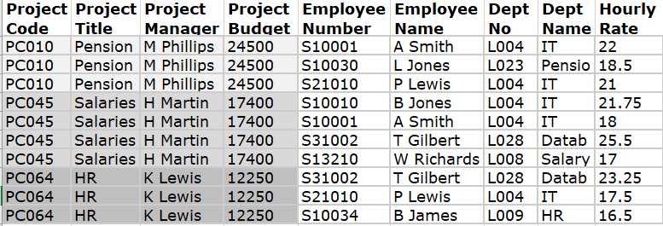
First Normal Form (1 NF)
Rule
An attribute (column) of a table cannot hold multiple values.
It should hold only atomic values.
Notes:
Step 2 Transform a table of unnormalised data into first normal form (1NF). any repeating attributes to a new table.
A repeating attribute is a data field within the UNF relation that may occur with multiple values for a single value of the key.
The process is as follows:
Identify repeating attributes.
Remove these repeating attributes to a new table together with a copy of the key from the UNF table.
Assign a key to the new table (and underline it).
The key from the original unnormalised table always becomes part of the key of the new table.
A compound key is created. The value for this key must be unique for each entity occurrence.
Notes: After removing the duplicate data the repeating attributes are easily identified.
In the previous table the Employee No, Employee Name, Department No, Department Name and Hourly Rate attributes are repeating.
That is, there is potential for more than one occurrence of these attributes for each project code.
These are the repeating attributes and have been to a new table together with a copy of the original key (ie: Project Code).
A key of Project Code and Employee No has been defined for this new table. This combination is unique for each row in the table.
The process is as follows: Take each non-key attribute in turn and ask the question: is this attribute dependent on one part of the key?
If yes, remove the attribute to a new table with a copy of the part of the key it is dependent upon.
The key it is dependent upon becomes the key in the new table. Underline the key in this new table.
If no, check against other part of the key and repeat above process If still no, ie: not dependent on either part of the key, keep attribute in current table.
Notes:
The first table went straight to 2NF as it has a simple key (Project Code).
Employee name, Department No and Department Name are dependent upon Employee No only.
Therefore, they were moved to a new table with Employee No being the key.
However, Hourly Rate is dependent upon both Project Code and Employee No as an employee may have a different hourly rate depending upon which project they are working on. Therefore it remained in the original table.

Slide 26
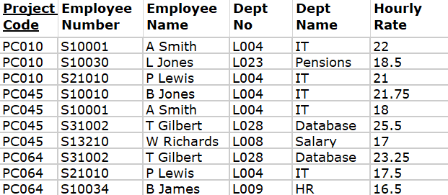
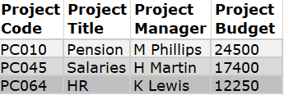
Second Normal Form (2 NF )
Rule 1- Be in 1NF
Rule 2- Single Column Primary Key
Repeating Attributes Removed
Before we Move to 2NF understand Functional Dependency
Notes:
Step 3
Transform 1NF data into second normal form (2NF). Remove any -key attributes (partial Dependencies) that only depend on part of the table key to a new table.What has to be determined "is field A dependent upon field B or vice versa?" This means: "Given a value for A, do we then have only one possible value for B, and vice versa?" If the answer is yes, A and B should be put into a new relation with A becoming the primary key. A should be left in the original relation and marked as a foreign key.
Ignore tables with (a) a simple key or (b) with no non-key attributes (these go straight to 2NF with no conversion).
The process is as follows:
Take each non-key attribute in turn and ask the question: is this attribute dependent on one part of the key?
If yes, remove the attribute to a new table with a copy of the part of the key it is dependent upon. The key it is dependent upon becomes the key in the new table. Underline the key in this new table.
If no, check against other part of the key and repeat above process
If still no, ie: not dependent on either part of the key, keep attribute in current table.
Notes:
The first table went straight to 2NF as it has a simple key (Project Code).
Employee name, Department No and Department Name are dependent upon Employee No only. Therefore, they were moved to a new table with Employee No being the key.
However, Hourly Rate is dependent upon both Project Code and Employee No as an employee may have a different hourly rate depending upon which project they are working on. Therefore it remained in the original table.

Slide 27
Functional Dependency
Functional Dependence:
The key column must be sufficient for determining values of the non-key columns.
An attribute depends on another attribute if the change of its value is caused by a change of that other attribute’s value.
From this perspective, the goal of the normalization process is to establish the Full Functional Dependence between the key and non-key columns, driving out other dependencies (Partial Functional Dependence, and Transitive Dependence).
determines
Full Functional Dependence
(Key determines non-key values)
Key
Non-key columns
determines
Partial Functional Dependence
(Part of Key determines some non-key values)
Key
Non-key columns
determines
Transitive Dependence (Non-key attribute
determines another non-key)
Key
Non-key columns

Slide 28
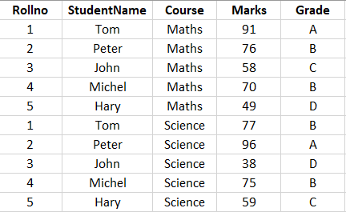
Example 1:for Functional Dependency
Marks attribute is not a key attribute, but marks determines grade, Hence it can be concluded that key attributes are determinants but not all the determinants are key attributes.
Also, Rollno and Course together (called composite key attribute) defines EXACTLY ONE value of marks. This can be symbolically represented as Rollno,Course → Marks. Thus, a determinant can be composite in nature
Notes:
Functional Dependency
Consider the EMP table following Relation, for a given value of EMPNO, there is one value of ENAME, SAL, COMM, DEPTNO, HIREDATE, MGR, JOB. All these functional dependencies are indicated as :
EMPNO-->ENAME, EMPNO-->SAL, EMPNO-->COMM, EMPNO-->DEPTNO, EMPNO-->HIREDATE, EMPNO-->MGR, EMPNO-->JOB

Slide 29
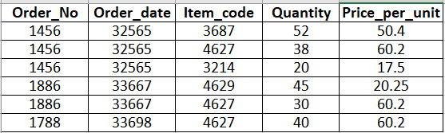
Example 2: for Functional Dependency
The following Functional Dependencies exist :
Order_No → Order_date, Item_code → Price_per_unit, Order_No+Item_code →Quantity
Notes:
Here, the key of the above relation is Order_no+Item_code(Composite Key).
The following Functional Dependencies exist :{Order_No → Order_date, Item_code → Price_per_unit, Order_No+Item_code →Quantity}.
Here, the attribute Order_date which is not a part of the key of the relation is called non-key attribute, and is not functionally dependent on the whole key(Order_No+Item_code), but is dependent on a part of the whole key, that is on Order_No.
Also, same is the case with the attribute Price_per_unit, which is dependent on a part of the whole key, that is on Item_code,
Only, the attribute Quantity is fully functionally dependent on the whole key(Order_No+Item_code).

Slide 30
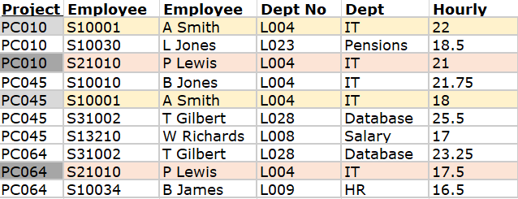
Continued with our example of Functional Dependancy
We say an attribute, B, has a functional dependency on another attribute, A, if for any two records, which have the same value for A, then the values for B in these two records must be the same.
Employee name, Department No and Department Name are dependent upon Employee No only.
Remove any -key attributes (partial Dependencies) that only depend on part of the key to a new table.

Slide 31
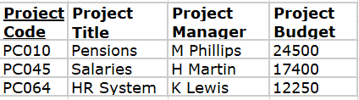
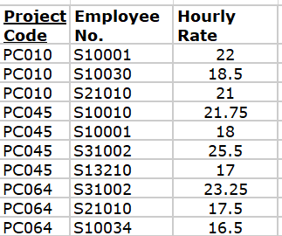
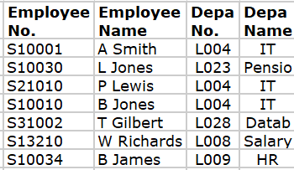
Third Normal Form (3 NF)

Slide 32
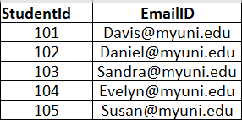
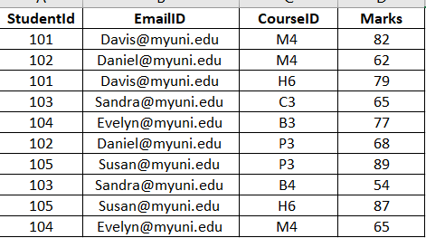
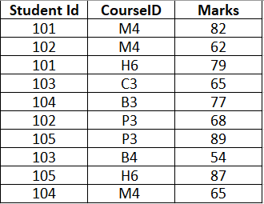
Boyce Codd Normal Form (BCNF)
A relation is said to be in Boyce Codd Normal Form (BCNF) if and only if all the determinants are candidate keys. BCNF relation is a strong 3NF, but not every 3NF relation is BCNF.
Notes:
In the RESULT table, we have two candidate keys namely Student#Course# and EmaiIId.Course#. Course# is overlapping among those candidate keys. Hence these candidate keys are called as “overlapping candidate keys”
The non-key attribute, Marks is non-transitively and fully functionally dependant on key attributes. Hence this is in 3NF. But this is not in BCNF because there are four determinants in this relation namely:
• Student# (Student# decides EmailiD)
• EMailID (EmailID decides Student#)
• Student# Course# (decides Marks)
• Course# EMailID (decides Marks)
All above determinants are not candidate keys. EMailID decides Student# but EMailID on its own is not a candidate key. Similarly Student# decides EMailID of
a student but Student# alone is not a candidate key. Only combination of (Student#, Course#) and (EMailID, Course#) are candidate keys. However, Student# decides EmailID and EMailID decides Student#, hence the duplication of data.
To make this table BCNF, we need to split this table into the following structure:
STUDENT TABLE
StudentId EmailID
101 Davis@myuni.edu
102 Daniel@myuni.edu
103 Sandra@myuni.edu
104 Evelyn@myuni.edu
105 Susan@myuni.edu
Student
Student Id CourseID Marks
101 M4 82
102 M4 62
101 H6 79
103 C3 65
104 B3 77
102 P3 68
105 P3 89
103 B4 54
105 H6 87
104 M4 65
Now both the tables are not only in 3NF, but also in BCNF because all the determinants are candidate keys. In the first table, Student# decides EMailID and EMailID decides Student# and both are candidate keys.
In second table, Student# Course# is only determinant and candidate key. Hence it qualifies BCNF definition that every determinant must be a candidate key.
If the table has only one non-composite/composite candidate key and if it is in 3NF, then the table will also be in BCNF.
Basically 2NF and 3NF takes away the redundancy, anomalies which exist among the key and non-key attributes. On other hand BCNF takes away the redundancy, anomalies which exist amongst the key attributes

Slide 33
Fourth Normal Form
Properties of 4NF:-
there is no multivalued dependency(a --->> b) in the relation or
there are multivalued dependencies but the attributes, which are multivalue dependent on a specific attribute, are dependent between themselves.
Notes:
Assume the following relation
R(a,b,c) having columns a, b and c and together the combination (a,b,c) is the key of the table
Recall that a relation is in BCNF if all its determinant are candidate keys, in other words each determinant can be used as a primary key.
Because relation R has only one determinant (a, b, c), which is the composite primary key, therefore R is in BCNF.
Now R may or may not be in fourth normal form.
If R contains no multi valued dependency then R will be in Fourth normal form.
Assume R has the following two-multi value dependencies:
a --->> b and a --->> c
In this case R will be in the fourth normal form if b and c dependent on each other.
However if b and c are independent of each other then R is not in fourth normal form and the relation has to be projected to form two non-loss projections. These non-loss projections will be in fourth normal form.
Assume the following relation with multi-value dependency:
Employee (Eid, Language, Skill) where (Eid, Language, Skill) is the composite primary key.
Multivalued Dependency is symbolically indicated as follows : X --->> Y, which means for a given value X, there are multiple values of Y.
In our case,:
Eid --->> Languages Eid --->> Skills
Languages and Skills are dependent.
This says an employee speaks several languages and has several skills. However for each skill, a specific language is used when that skill is practiced
Eid Language Skill
100 English Teaching
100 Kurdish Singing
100 French Cooking
200 English Cooking
200 Arabic Singing
Thus employee 100 when he/she teaches speaks English but when he cooks, he cooks French. This relation is in fourth normal form and does not suffer from any anomalies.
Now, assume :
Eid --->> Languages Eid --->> Skills
Languages and Skills are Independent.
This relation is not in fourth normal form and suffers from all three types of anomalies.

Slide 34
Fifth Normal Form
A table is in fifth normal form (5NF) or Project-Join Normal Form (PJNF) if it is in 4NF and it cannot have a lossless decomposition into any number of smaller tables.
Properties of 5NF:-
Anomalies can occur in relations in 4NF if the primary key has three or more fields.
5NF is based on the concept of join dependence - if a relation cannot be decomposed any further then it is in 5NF.
Pair wise cyclical dependency means that:
For any one you must know the other two (cyclical).

Slide 35
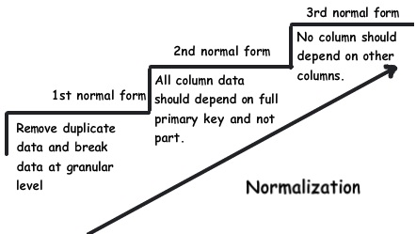
Summery
Notes:
However, as the end user, we need not concern ourselves with pulling the data from
different locations. On providing the appropriate command, the RDBMS will ensure all
the relevant data is presented to you in the specified manner. As the end-user, we only
need to relate to the data in the simple TABLE structure of rows and columns.

Slide 36
Summary of Normal Forms
1) If a table has repeating sections, there is huge redundancy, different classes are mixed together, and all anomalies occur. Split the table, so that classes are clearly differentiated. Result: 1NF.
1NF: A table is in 1NF if it does not have repeating sections.
2) If a table has a combined key, non-key columns may depend on just a part of the primary key, and so there is partial functional dependency. Split the table so that in new tables non-keys depend on the entire key. Result: 2NF.
2NF: A table is in 2NF if it is in 1NF and non-key columns depend on the entire combined key.
3) If a non-key depends on another non-key, there is transitive dependency. Split the table so that in new tables each non-key depends on the key and nothing but the key. Result: 3NF.
3NF: A table is in 3NF if it is in 2NF and all non-key columns depend on the key only.

Slide 37
Module 2
Database design

Slide 38
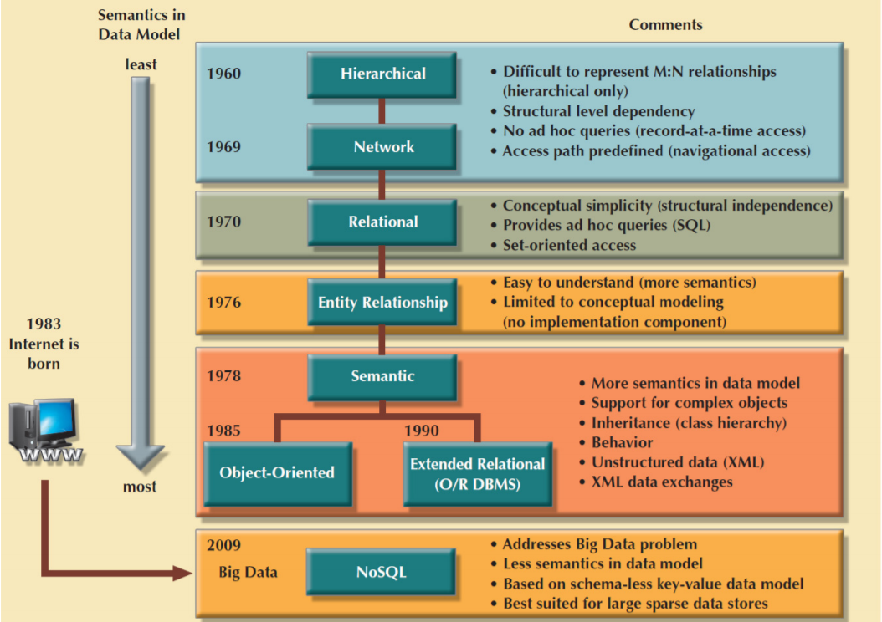
Evolution of ER Models

Slide 39
Entity Relationship Model
An entity–relationship model (ER model) is a systematic way of describing and defining a business process.
Widely accepted standard for data modeling
Introduced by Chen in 1976
Graphical representation of entities and their relationships in a database structure
Entity relationship diagram (ERD) – Uses graphic representations to model database components – Entity is mapped to a relational table

Slide 40
Relationships
A relationship is an association among (two or more) entities.
Types :
1:1
An academic department is chaired by one professor; a professor may chair only one academic department.
1:M
A customer may generate many invoices; each invoice is generated by one customer.
M:N
An employee may have earned many degrees; a degree may have been earned by many employees.

Slide 41
Keys
Superkey
Composite key
Candidate key
Primary key
Alternate key
Secondary key
Foreign key
Notes:
Keys
Superkey: an attribute or set of attributes that uniquely identifies an entity--there can be many of these
Composite key: a key requiring more than one attribute
Candidate key: a superkey such that no proper subset of its attributes is also a superkey (minimal superkey – has no unnecessary attributes)
Primary key: the candidate key chosen to be used for identifying entities and accessing records. Unless otherwise noted "key" means "primary key"
Alternate key: a candidate key not used for primary key
Secondary key: attribute or set of attributes commonly used for accessing records, but not necessarily unique
Foreign key: term used in relational databases (but not in the E-R model) for an attribute that is the primary key of another table and is used to establish a relationship with that table where it appears as an attribute also.
So a foreign key value occurs in the table and again in the other table. This conflicts with the idea that a value is stored only once; the idea that a fact is stored once is not undermined.

Slide 42
Data Model Basic Building Blocks Terminology
Entity: anything about which data are to be collected and stored
Attribute: a characteristic of an entity
Relationship: describes an association among entities
– One-to-many (1:M) relationship
– Many-to-many (M:N or M:M) relationship
– One-to-one (1:1) relationship
• Constraint: a restriction placed on the data
Notes:
Entities and Attributes
Entity: an object that is involved in the enterprise and that be distinguished from other objects. (not shown in the ER diagram--is an instance)
Can be person, place, event, object, concept in the real world
Can be physical object or abstraction
Ex: "John", "CSE305"
Entity Type: set of similar objects or a category of entities; they are well defined
A rectangle represents an entity set
Ex: students, courses
We often just say "entity" and mean "entity type"
Attribute: describes one aspect of an entity type; usually [and best when] single valued and indivisible (atomic)
Represented by oval on E-R diagram
Ex: name, maximum enrollment
May be multi-valued – use double oval on E-R diagram
May be composite – attribute has further structure; also use oval for composite attribute, with ovals for components connected to it by lines
May be derived – a virtual attribute, one that is computable from existing data in the database, use dashed oval. This helps reduce redundancy

Slide 43
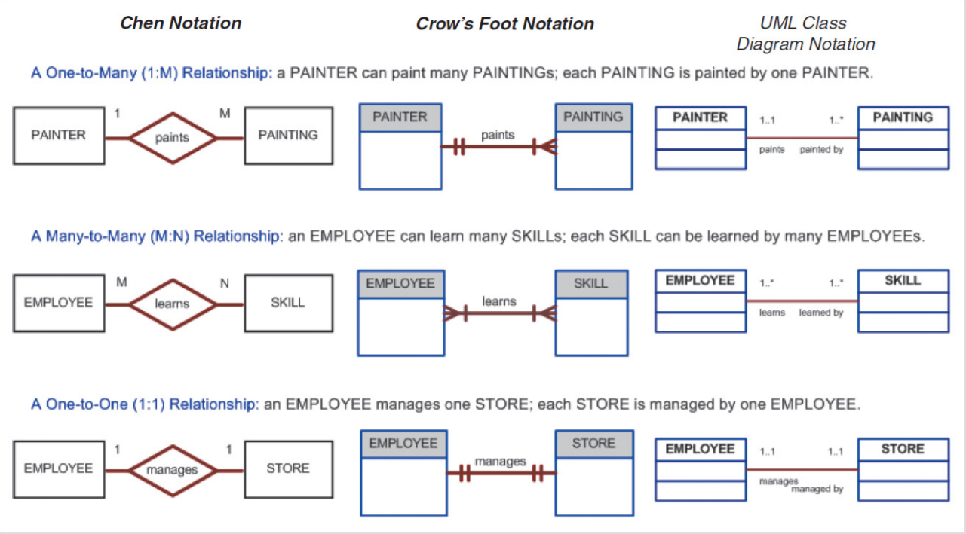
ER Model Notations
Notes:
Entity Types
An entity type is named and is described by set of attributes
Student: Id, Name, Address, Hobbies
Domain: possible values of an attribute.
Note that the value for an attribute can be a set or list of values, sometimes called "multi-valued" attributes
This is in contrast to the pure relational model which requires atomic values
E.g., (111111, John, 123 Main St, (stamps, coins))
Key: subset of attributes that uniquely identifies an entity (candidate key)
Entity Schema:
The meta-information of entity type name, attributes (and associated domain), key constraints
Entity Types tend to correspond to nouns; attributes are also nouns albeit descriptions of the parts of entities
May have null values for some entity attribute instances – no mapping to domain for those instances

Slide 44
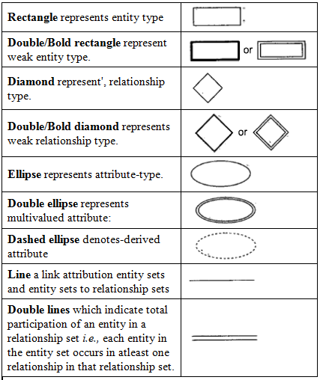
Notations Used in ER Model

Slide 45
Example : Requirement of business model -The Flight Database
The flight database stores details about an airline’s fleet, flights, and seat bookings.
Consider the following requirements list:
The airline has one or more airplanes.
An airplane has a model number, a unique registration number,
and the capacity to take one or more passengers.
An airplane flight has a unique flight number, a departure airport,
a destination airport, a departure date and time, and an arrival date and time.
Each flight is carried out by a single airplane.
A passenger has given names, a surname, and a unique email address.
A passenger can book a seat on a flight.

Slide 46
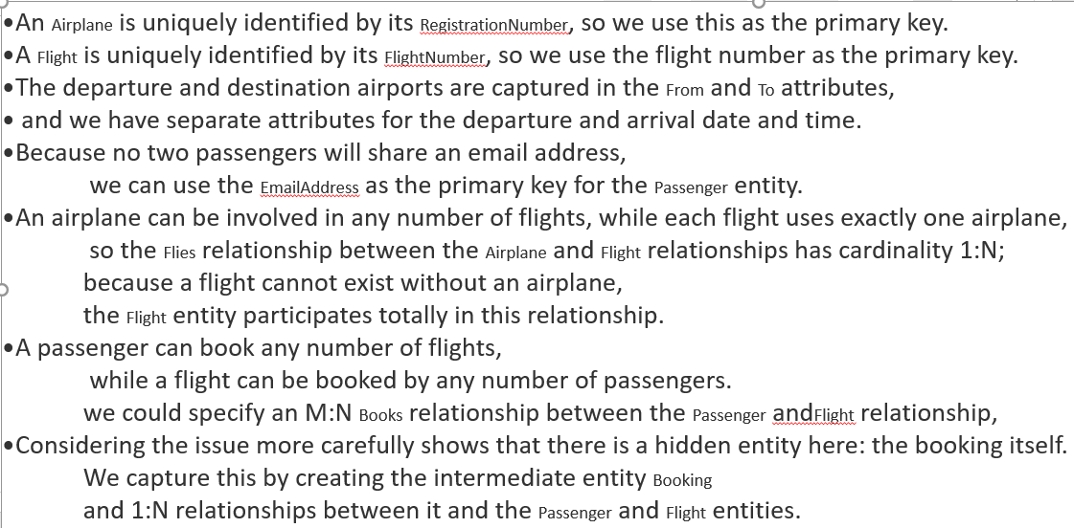
Explanation of above ER Model
Notes:
An Airplane is uniquely identified by its RegistrationNumber, so we use this as the primary key.
A Flight is uniquely identified by its FlightNumber, so we use the flight number as the primary key. The departure and destination airports are captured in the From and To attributes, and we have separate attributes for the departure and arrival date and time.
Because no two passengers will share an email address, we can use the EmailAddress as the primary key for the Passenger entity.
An airplane can be involved in any number of flights, while each flight uses exactly one airplane, so the Flies relationship between the Airplane and Flight relationships has cardinality 1:N; because a flight cannot exist without an airplane, the Flight entity participates totally in this relationship.
A passenger can book any number of flights, while a flight can be booked by any number of passengers. As discussed earlier in Intermediate Entities,” we could specify an M:N Books relationship between the Passenger andFlight relationship, but considering the issue more carefully shows that there is a hidden entity here: the booking itself. We capture this by creating the intermediate entity Booking and 1:N relationships between it and the Passenger and Flight entities. Identifying such entities allows us to get a better picture of the requirements. Note that even if we didn’t notice this hidden entity, it would come out as part of the ER-to-tables mapping process we’ll describe next in Using the Entity Relationship Model.”

Slide 47
An Airplane is uniquely identified by its RegistrationNumber, so we use this as the primary key.
A Flight is uniquely identified by its FlightNumber, so we use the flight number as the primary key.
The departure and destination airports are captured in the From and To attributes, and we have separate attributes for the departure and arrival date and time.
Because no two passengers will share an email address, we can use the Email Address as the primary key for the Passenger entity.
An airplane can be involved in any number of flights, while each flight uses exactly one airplane, so the Flies relationship between the Airplane and Flight relationships has cardinality 1:N;
A passenger can book any number of flights, while a flight can be booked by any number of passengers. we could specify an M:N Books relationship between the Passenger and Flight relationship.
There is a hidden entity here: the booking itself. 1:N relationships between Book entity and the Passenger and Flight entities.
Notes:
An Airplane is uniquely identified by its Registration Number, so we use this as the primary key.
A Flight is uniquely identified by its Flight Number, so we use the flight number as the primary key. The departure and destination airports are captured in the From and To attributes, and we have separate attributes for the departure and arrival date and time.
Because no two passengers will share an email address, we can use the Email Address as the primary key for the Passenger entity.
An airplane can be involved in any number of flights, while each flight uses exactly one airplane, so the Flies relationship between the Airplane and Flight relationships has cardinality 1:N; because a flight cannot exist without an airplane, the Flight entity participates totally in this relationship.
A passenger can book any number of flights, while a flight can be booked by any number of passengers. As discussed earlier in Intermediate Entities,” we could specify an M:N Books relationship between the Passenger and Flight relationship, but considering the issue more carefully shows that there is a hidden entity here: the booking itself. We capture this by creating the intermediate entity Booking and 1:N relationships between it and the Passenger and Flight entities. Identifying such entities allows us to get a better picture of the requirements. Note that even if we didn’t notice this hidden entity, it would come out as part of the ER-to-tables mapping process we’ll describe next in Using the Entity Relationship Model.”

Slide 48
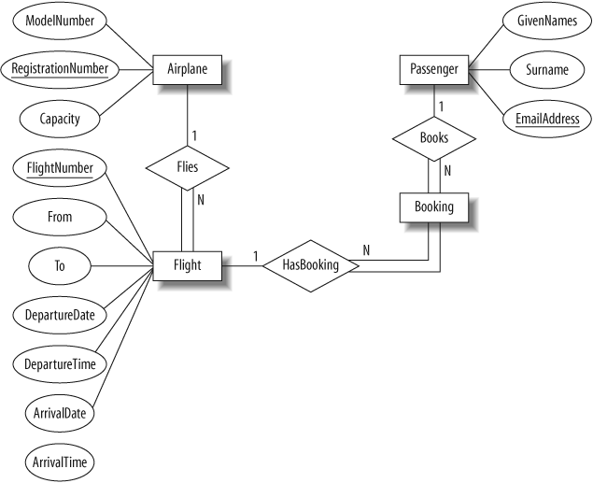
The Flight Database
The ER diagram derived from our requirements

Slide 49
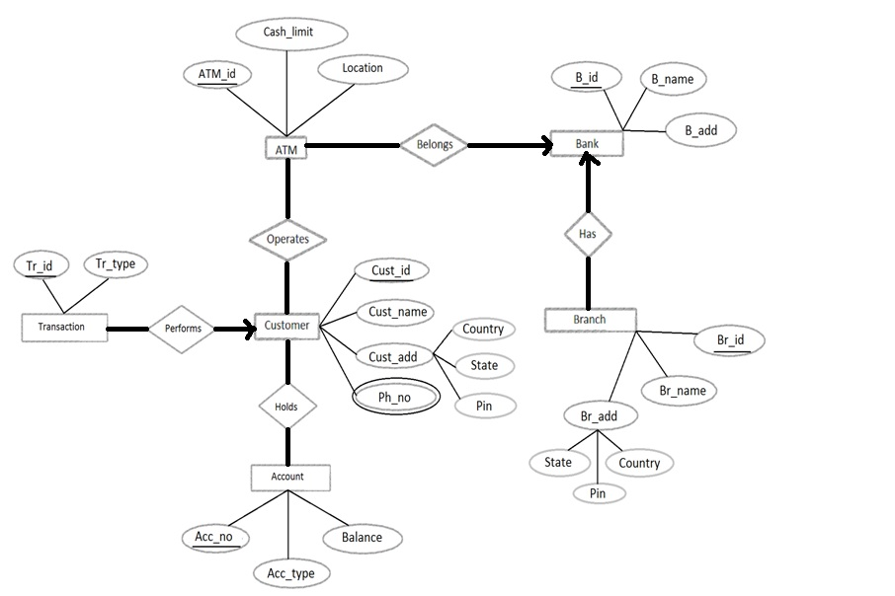
Example: Self study
Notes:
Solution:
Strong entity sets
At first, let us identify and reduce all the strong entity sets (those that have primary keys) into relational schemas.
In the given diagram, ATM, Bank, Transaction, Customer, Branch, and Account are strong entity sets. To do this, we can use the name of the entity sets as schema names and all the attributes as part of the schema. In this way, we have the following schemas;
ATM (ATM_id, cash_limit, location)
Bank (B_id, B_name, B_add)
Branch (Br_id, Br_name, Br_add)
Transaction (Tr_id, Tr_type)
Customer (Cust_id, Cust_name, Cust_add, Ph_no)
Account (Acc_no, Acc_type, Balance)
Primary keys are underlined
Composite attributes
In entity sets Branch and Customer, the attributes Br_add and Cust_add respectively are composite attributes. To reduce the composite attributes we retain the component attributes in the schema. That is, instead of Br_add, we shall include the component attributes state, country and pin the Branch table as follows;
Branch (Br_id, Br_name, State, Country, Pin)
Likewise, Customer becomes;
Customer (Cust_id, Cust_name, State, Country, Pin, Ph_no)
Multi-valued attributes
Ph_no attribute of Customer entity set is a multi-valued attribute. That is, it can have one or more values in it per record (row). To reduce the multi_valued attribute, we need to create a separate table with a new name with the multi_valued attribute as one attribute along with the primary key of the base entity set as follows;
Customer_Phone (Cust_id, Ph_no)
The primary key for this relation is both (cust_id, ph_no).
Relationship sets
We have the following type of relationships in the given ER diagram;
Belongs – a one-to-many relationship from Bank to ATM. One bank can have many ATMs (and an ATM can belong to at most one Bank).
Has – a one-to-many relationship from Bank to Branch. One bank can have many branches (and a branch can belong to only one bank).
Operates – a many-to-many relationship from ATM to Customer. A customer can operate many ATMs and an ATM can be operated by many customers.
Performs – a many-to-one relationship from Transaction to Customer. A transaction can be performed by only one customer (and a customer can perform any number of transactions).
Holds – a many-to-many relationship from Customer to Account. A customer can have any number of accounts and an account can be maintained by more than one customer as joint accounts.
- For a many-to-many relationship, we need to create a separate schema by including the primary keys of participating entity sets as attributes.
- For all others, the primary key of one side has to be included as the foreign key of the other side (no need to create a separate table).
Hence, we have the following changes;
Operates (ATM_id, Cust_id) - many-to-many
Holds (Cust_id, Acc_no) – many-to-many
For Belongs, include B_id (primary key of Bank, one side) in ATM entity set (many side).
ATM (ATM_id, cash_limit, location, B_id)
For Has, include B_id (primary key of Bank, one side) in Branch entity set (many side).
Branch (Br_id, Br_name, State, Country, Pin, B_id)
For Performs, include Cust_id (primary key of Customer, one side) in Transaction entity set (many side).
Transaction (Tr_id, Tr_type, Cust_id).
At the end, after reduction and modification, we have the following set of relation schemas for the given ER diagram;
Bank (B_id, B_name, B_add)
Customer (Cust_id, Cust_name, State, Country, Pin)
Customer_Phone (Cust_id, Ph_no)
ATM (ATM_id, cash_limit, location, B_id)
Branch (Br_id, Br_name, State, Country, Pin, B_id)
Transaction (Tr_id, Tr_type, Cust_id)
Operates (ATM_id, Cust_id)
Holds (Cust_id, Acc_no)

Slide 50
Module 3
Basic SELECT operations

Slide 51
SQL Commands :
Data Query Language(DQL)
SELECT
Data Definition Language (DDL)
CREATE, ALTER, DROP, TRUNCATE, RENAME, COMMENT
Data Manipulation Language(DML)
INSERT, UPDATE, DELETE, (MERGE)
Data Control Language(DCL)
GRANT, REVOKE
Transaction control Language(TCL)
COMMIT, ROLLBACK, SAVEPOINT

Slide 52
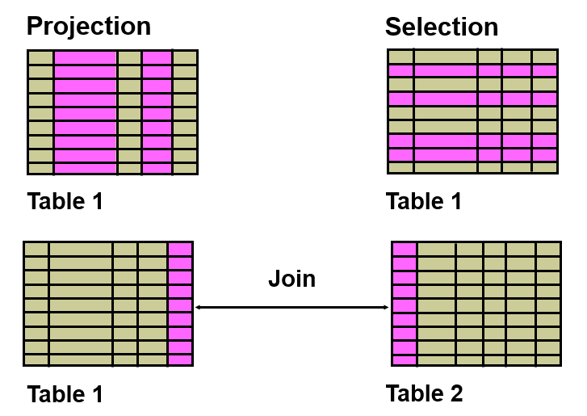
Capabilities of SQL SELECT Statements
Notes:
A SELECT statement retrieves information from the database. Using a SELECT statement, you can do the following:
Selection: You can use the selection capability in SQL to choose the rows in a table that you want returned by a query. You can use various criteria to selectively restrict the rows that you see.
Projection: You can use the projection capability in SQL to choose the columns in a table that you want returned by your query. You can choose as few or as many columns of the table as you require
Join: You can use the join capability in SQL to bring together data that is stored in different tables by creating a link through a column that both the tables share. You will learn more about joins in a later lesson.

Slide 53
Basic SELECT Command
SELECT is used for retrieving data from database tables
SELECT identifies the columns to be displayed.
FROM identifies the table containing those columns
SELECT
[DISTINCT | ALL] <column-list>
FROM <table-names>
[WHERE <condition>]
[ORDER BY <column-list>]
[GROUP BY <column-list>]
[HAVING <condition>]
([]- optional, | - or)

Slide 54
Selecting All Columns
Selecting All Columns
SELECT * FROM employees;
Selecting specific Columns
The columns to be selected from a table are speciﬁed after the keyword select. This operation is also called projection.
SELECT first_name, last_name, hire_date FROM employees;

Slide 55
WHERE clause- Filtering Data
For selection of tuples that satisfy certain conditions, the where clause is used.
In a where clause simple conditions based on comparison operators can be combined using the logical connectives and, or, and not to form complex conditions.
Conditions may also include pattern matching operations and even subqueries
SELECT * FROM employees WHERE rownum <11;
Notes:
List the job title and the salary of those employees whose manager has the number 7698 or 7566 and who earn more than 1500:

Slide 56
ORDER BY clause
Order by clause has one or more attributes listed in the select clause as parameter.
desc speciﬁes a descending order
asc speciﬁes an ascending order (default order).
SELECT first_name, department_id as , hire_date from employees order by department_id ;
Sorting by Multiple Columns
SELECT first_name, department_id as , hire_date from employees order by department_id asc, hire_date desc;

Slide 57
Distinct clause
If a table has duplicate data, you can use the DISTINCT clause to eliminate the duplicate values
select DISTINCT job_id from employees
Distinct on multiple columns
select DISTINCT job_id,department_id from employees ORDER BY job_id

Slide 58
Comparison Operators
Comparison operators compare a certain column value with several other column values.
These are the main comparison operators:
BETWEEN: Tests whether a value is between a pair of values
IN: Tests whether a value is in a list of values
LIKE: Tests whether a value follows a certain pattern, as shown here:

Slide 59
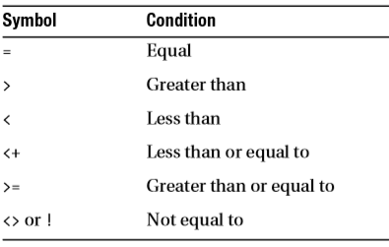
Comparison operators
SELECT employee_id FROM employees WHERE salary = 50000;
SELECT employee_id FROM employees WHERE salary < 50000;
SELECT employee_id FROM employees WHERE salary >= 50000;
SELECT employee_id FROM employees WHERE salary != 50000;

Slide 60
IN /NOT IN and Between Operator
If any item in the list following a NOT IN operation is null, all rows evaluate to UNKNOWN (and no rows are returned.
You use the BETWEEN operator to select rows whose column value is inclusive within a specified range.
The range specified with the BETWEEN operator is inclusive.
select ∗ from departments where department_id IN (20,30);
select ∗ from departments where department_id NOT IN (20,30);
select * from Employees where SALary between 15000 and 25000;
select * from Employees where HIRE_DATE between '02-01-03' and '02-01-04';

Slide 61
The LIKE Operator
The LIKE condition uses pattern matching to restrict rows in a SELECT statement.
SELECT employee_id, last_name FROM employees WHERE last_name LIKE 'Fa%';
The pattern should be enclosed in single quotes (' ‘).
The percent sign (%) acts as a wildcard for one or more characters
The asterisk (*) acts as many or all characters .
The single underscore character (_) acts as a wildcard for one and only one character.

Slide 62
NULL value
NULL is a special value that means:
unavailable
unassigned
unknown
inapplicable
NULL value is not equivalent to
zero
blank space
The operations = null and ! = null are not deﬁned!
select employee_id,manager_id from employees where manager_id IS NOT NULL;

Slide 63
Logical Operators
The logical operators, also called Boolean operators, logically compare two or more values.
The main logical operators are AND, OR, NOT
When there are multiple operators within a single statement, you need rules of precedence.
The following is the order of precedence of operators in Oracle, with the most important first:
=, !=, <, >, <=, >= IS NULL, LIKE, BETWEEN, IN, EXISTS NOT AND OR
SELECT * FROM employees WHERE JOB_ID= 'AC_MGR' AND department_id = 110 ;
SELECT * FROM employees WHERE JOB_ID= 'AC_MGR' OR department_id = 110 ;

Slide 64
A COLUMN ALIAS
Renames a column heading
Is useful with calculations
Immediately follows the column name (There can also be the optional AS keyword between the column name and alias.)
Requires double quotation marks (“ “) if it contains spaces or special characters, or if it is case-sensitive
SELECT last_name AS Surname, commission_pct commission FROM employees
WHERE commission_pct IS NOT NULL;

Slide 65
Oracle Built-in Datatypes
CHAR (size) fixed-length char array
VARCHAR2(size) Variable-length char string
NUMBER (precision, scale) any numeric
DATE date
TIMESTAMP date+time
CLOB char large object
BLOB binary large object
BINARY_FLOAT 32 bit floating point
BINARY_DOUBLE 64 bit floating point
… + some others

Slide 66
Conversion Functions
The most common of these functions are:
TO_CHAR function converts a floating number to a string.
TO_NUMBER function converts a floating number or a string to a number.
TO_DATE function converts character data to a DATE data type.
SELECT TO_CHAR(TO_DATE('20-JUL-08', 'DD-MON-RR') ,'YYYY') "Year" FROM DUAL;
SELECT TO_CHAR(SYSDATE, 'DD-MON-YYYY') FROM DUAL;

Slide 67
BUILT-IN Oracle functions
Built-In Oracle functions help you perform many transformations quickly,
without your having to do any coding.
Single-row functions,
Aggregate functions,
Number functions
Date functions,
General and Conditional functions,
Analytical functions.

Slide 68
Single-Row Functions
Single-row functions are typically used to perform tasks such as converting a lowercase word to uppercase or vice versa, or replacing a portion of text in a row.

Slide 69
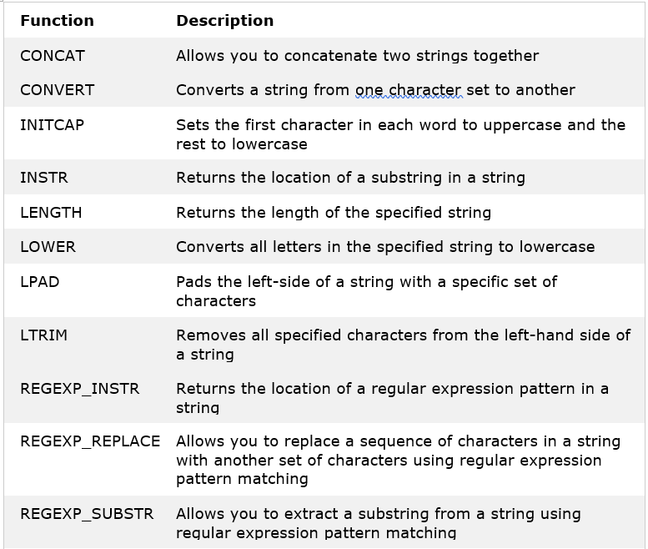
Character Functions :
Notes:
Character Functions
SELECT CONCAT('ONE',TWO') FROM DUAL;
SELECT CONCAT(FIRST_NAME,LAST_NAME) FROM EMPLOYEES;
SELECT CHR(125) FROM DUAL;
SELECT ASCII('}') FROM DUAL;
SELECT INITCAP('STRING') FROM DUAL;
SELECT LOWER(FIRST_NAME) FROM EMPLOYEES;
SELECT UPPER(FIRST_NAME) FROM EMPLOYEES;
SELECT LPAD(FIRST_NAME,20,'*') FROM EMPLOYEES;
SELECT RPAD(FIRST_NAME,20,'*') FROM EMPLOYEES;
SELECT LTRIM(' TEST') FROM DUAL;
SELECT LTRIM('ALLEN','AL') FROM DUAL; {RTRIM works similarly}
SELECT SUBSTR('ALLEN',2) FROM DUAL
SELECT SUBSTR('ALLEN',2,3) FROM DUAL
SELECT REPLACE ('PIVOT','PIV','IDI') FROM DUAL;
SELECT REPLACE('ALLEN','AL') FROM DUAL;
SELECT REPLACE('ABC','A','XY') FROM DUAL;
SELECT TRANSLATE('ABC','A','XY') FROM DUAL;
SELECT LENGTH(FIRST_NAME) FROM EMPLOYEES;
SELECT INSTR('ALLEN','L') FROM DUAL;
SELECT INSTR('ALLEN','L',2,2) FROM DUAL;
SELECT FIRST_NAME FROM EMPLOYEES WHERE SOUNDEX(FIRST_NAME) =
SOUNDEX('NEENO')
SELECT FIRST_NAME, DECODE (DEPARTMENT_ID, 10, 'ADMINISTRATION', 20,
'MARKETING', 'OTHERS') FROM EMPLOYEES

Slide 70
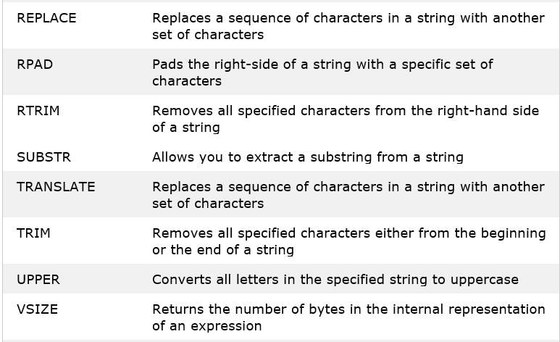
Character Functions :
Notes:
Character Functions
SELECT CONCAT('ONE',TWO') FROM DUAL;
SELECT CONCAT(FIRST_NAME,LAST_NAME) FROM EMPLOYEES;
SELECT CHR(125) FROM DUAL;
SELECT ASCII('}') FROM DUAL;
SELECT INITCAP('STRING') FROM DUAL;
SELECT LOWER(FIRST_NAME) FROM EMPLOYEES;
SELECT UPPER(FIRST_NAME) FROM EMPLOYEES;
SELECT LPAD(FIRST_NAME,20,'*') FROM EMPLOYEES;
SELECT RPAD(FIRST_NAME,20,'*') FROM EMPLOYEES;
SELECT LTRIM(' TEST') FROM DUAL;
SELECT LTRIM('ALLEN','AL') FROM DUAL; {RTRIM works similarly}
SELECT SUBSTR('ALLEN',2) FROM DUAL
SELECT SUBSTR('ALLEN',2,3) FROM DUAL
SELECT REPLACE ('PIVOT','PIV','IDI') FROM DUAL;
SELECT REPLACE('ALLEN','AL') FROM DUAL;
SELECT REPLACE('ABC','A','XY') FROM DUAL;
SELECT TRANSLATE('ABC','A','XY') FROM DUAL;
SELECT LENGTH(FIRST_NAME) FROM EMPLOYEES;
SELECT INSTR('ALLEN','L') FROM DUAL;
SELECT INSTR('ALLEN','L',2,2) FROM DUAL;
SELECT FIRST_NAME FROM EMPLOYEES WHERE SOUNDEX(FIRST_NAME) =
SOUNDEX('NEENO')
SELECT FIRST_NAME, DECODE (DEPARTMENT_ID, 10, 'ADMINISTRATION', 20,
'MARKETING', 'OTHERS') FROM EMPLOYEES

Slide 71
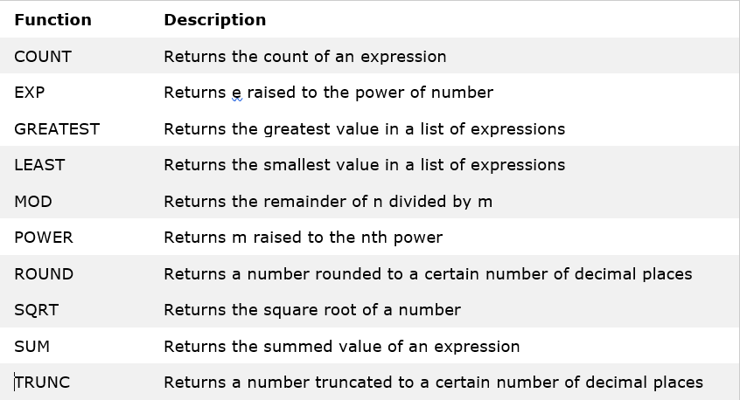
Number Functions
Notes:
Numeric Functions
SELECT ROUND(24.5) FROM DUAL;
SELECT ROUND(24.35,1) FROM DUAL; (no. of decimal places to round up to)
SELECT ROUND(1900,-3) FROM DUAL; (round up to nearest 1000)
SELECT ROUND(1370,-2) FROM DUAL; (round up to nearest hundred)
SELECT ROUND(17,-1) FROM DUAL; (round up to nearest 10)
SELECT TRUNC(24.60) FROM DUAL;
SELECT SALARY,TRUNC(SALARY,-3) FROM EMPLOYEES;
SELECT CEIL(15.8) FROM DUAL;
SELECT CEIL(15.1) FROM DUAL;
SELECT FLOOR(15.8) FROM DUAL;
SELECT FLOOR(15.1) FROM DUAL;
SELECT SIGN(-15) FROM DUAL;
SELECT SIGN(15) FROM DUAL;
SELECT SIGN(0) FROM DUAL;
SELECT MOD(12,4) FROM DUAL; (returns remainder of division operation)
SELECT MOD(5,2) FROM DUAL;
SELECT SQRT(25) FROM DUAL;
SELECT POWER(2,3) FROM DUAL;
SELECT ABS(-15) FROM DUAL;
55

Slide 72
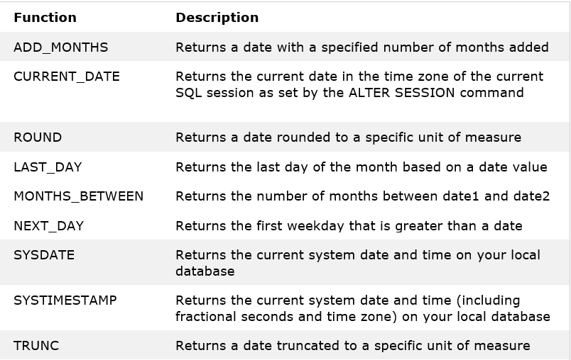
Date Functions
Notes:
SELECT ROUND (SYSDATE,'DD') FROM DUAL; (closest date to 12:00 a.m.)
SELECT ROUND (SYSDATE,'DY') FROM DUAL; (date of closest Sunday)
SELECT ROUND (SYSDATE,'MM') FROM DUAL; (nearest 1'st of month)
SELECT ROUND (SYSDATE,'YY') FROM DUAL; (nearest 1'st of Jan)
SELECT TRUNC (SYSDATE,'MM') FROM DUAL; (1'st of the month and similarly for all)
SELECT ADD_MONTHS(SYSDATE,2) FROM DUAL;
SELECT MONTHS_BETWEEN(SYSDATE,HIRE_DATE) FROM EMPLOYEES;
SELECT LAST_DAY(SYSDATE) FROM DUAL;
SELECT NEXT_DAY(SYSDATE) FROM DUAL;
SELECT NEXT_DAY(SYSDATE,'SAT') FROM DUAL;
Conversion Functions
SELECT LAST_DAY(TO_DATE('6-JAN-2010') FROM DUAL;
SELECT TO_CHAR(SYSDATE,'MON') FROM DUAL;
SELECT TO_CHAR(SYSDATE('HH:MI:SS') FROM DUAL;
You can use to_char to extract components of a date value

Slide 73
Aggregate Functions
To compute things such as averages and totals of a selected column in a query.
MIN: The MIN function returns the smallest value.
MAX: The MAX function returns the largest value.
AVG: The AVG function computes the average value of a column.
SUM: The SUM function computes the sum of a column:
COUNT: The COUNT function returns the total number of columns.
COUNT(*): The COUNT(*) function returns the number of rows in a table.
SELECT MIN(hire_date) , max(hire_date ) FROM employees;

Slide 74
General and Conditional Functions
The conditional functions help you decide among several choices.
NVL: The NVL function replaces the value in a table column with the value after the comma if the column is null. Thus, the NVL function takes care of column values if the column values are null and converts them to non-null values:
SELECT last_name,salary , salary * NVL (commission_pct,0)/100 as COMM FROM employees;
SELECT SALARY,commission_pct, SALARY+NVL(commission_pct,0)
FROM EMPLOYEES where SALARY>10000;
SELECT SALARY,commission_pct,NVL2(COMMISSION_PCT,SALARY+(SALARY*COMMISSION_PCT), SALARY) TOTAL
FROM EMPLOYEES where SALARY>10000;
COALESCE: This function is similar to NVL, but it returns the first non-null value in the list:
SELECT last_name, COALESCE(commission_pct, salary, 10) comm FROM employees ORDER BY commission_pct;

Slide 75
General and Conditional Functions
DECODE: To incorporate basic if-then functionality into SQL code.
SELECT last_name, job_id, salary, DECODE(job_id, 'IT_PROG', 1.10*salary, 'ST_CLERK',
1.15*salary, 'SA_REP', 1.20*salary,salary) REVISED_SALARY FROM employees;
CASE:
SELECT last_name, commission_pct,
(CASE commission_pct
WHEN 0.1 THEN 'Low'
WHEN 0.15 THEN 'Average'
WHEN 0.2 THEN 'High'
ELSE 'N/A' END ) Commission
FROM
employees
ORDER BY
last_name;
Notes:
SELECT last_name, job_id, salary, DECODE(job_id, ’IT_PROG’, 1.10*salary, ’ST_CLERK’, 1.15*salary, ’SA_REP’, 1.20*salary,salary) REVISED_SALARY FROM employees;

Slide 76
Analytical Functions
Ranking functions: These enable you to rank items in a data set according to some criteria.
Oracle has several types of ranking functions, including RANK, DENSE_RANK, CUME_DIST, PERCENT_ RANK, and NTILE.
rank() over( [partition by column] order by column )
select first_name, salary,
RANK() OVER (PARTITION BY department_id ORDER BY salary)
from employees
where department_id = 80;
Notes:
SELECT * FROM ( SELECT d.department_name, e.last_name, e.salary ,RANK() OVER ( PARTITION BY e.department_id ORDER BY e.salary) AS rank FROM employees e, departments d WHERE e.department_id = d.department_id AND d.department_id IN ('20','30', '40') ORDER BY d.department_name, e.salary, e.last_name, rank ) WHERE rank <=3;

Slide 77
Thank You

